Slide 1


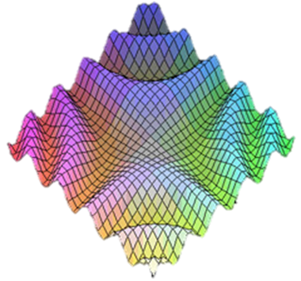

JavaScript Modules and Patterns
Private Fields, Module, Revealing Module, Revealing Prototype, …
SoftUni Team
Technical Trainers
JS Patterns
Software University
http://softuni.bg

Slide 2

Table of Contents
Public / Private Fields in JavaScript
"Module" Pattern
"Revealing Module" Pattern
"Revealing Prototype" Pattern
"Singleton" Pattern
Method Chaining
JS Patterns

Slide 3
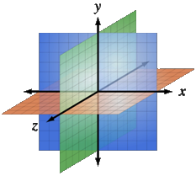
Public / Private Fields in JS
Using the Function Scope

Slide 4
Public / Private Fields
In JS each variable is defined either:
In the global scope (public)
In a function scope (private)
var global = 5;
function myFunction() {
var private = global;
function innerFunction(){
var innerPrivate = private;
}
}
global is available in myFunction

Slide 5

Public / Private Fields
Live Demo

Slide 6
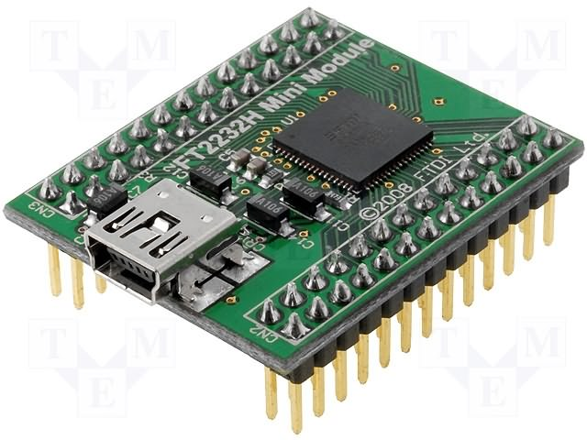
The "Module" Pattern
Hiding Members

Slide 7
Module Pattern: Structure
var module = (function() {
var privateVar = 5; // private variables
function privateFunc() { … } // private functions
return {
someFunc: function() {…},
anotherFunc: function() {…}
};
}());
Public members

Slide 8
Module Pattern: Example
var controls = (function () {
function formatResult(name, value) { … }
return {
Calculator: function (name) {
var result;
result = 0;
this.add = function (x) { … };
this.showResult = function () { … };
}
};
}());
var calc = new controls.Calculator('First');
calc.add(7);
calc.showResult();
Private function
The visible members create a closure with the private members

Slide 9
Module Pattern – Pros and Cons
Pros:
“Modularize” code into re-useable objects
Variables / functions are NOT in the global scope
Expose only public members
Hide internal data and functions
Cons:
Not easy to extend
Some complain about debugging

Slide 10
Module Pattern – Summary
Module pattern provides encapsulation of variables and functions
Provides a way to add visibility
Public versus private members
Each object instance creates new copies of functions + variables in memory

Slide 11

Module Pattern
Live Demo

Slide 12

The Revealing Module Pattern
Revealing Module
JS Patterns
Reveal the Most Interesting Members

Slide 13
Revealing Module Pattern: Structure
var module = (function() {
var privateVar = 5; // hidden variable
function privateFunction(…) { … } // hidden function
function someFunc(…) { … }
function anotherFunc(…) { … }
return {
someFunc: someFunc
anotherFunc: anotherFunc
};
}());
Expose only public members

Slide 14
Revealing Module Pattern – Example
var controls = (function () {
function formatResult(name, value) { … }
var Calculator = (function () {
var Calculator = function (name) { … };
Calculator.prototype.add = function (x) { … };
Calculator.prototype.subtract = function (x) { … };
Calculator.prototype.showResult = function () { … };
return Calculator;
}());
return {
Calculator: Calculator
};
}());
var calc = new controls.Calculator('First');
Hidden function
Create a function constructor hidden
Expose (reveal) only public members

Slide 15
Revealing Module Pattern – Pros and Cons
Pros:
"Modularize" code into re-useable objects
Variables / functions taken out of the global namespace
Expose only visible members
"Cleaner" way to expose members
Easy to change members privacy
Cons:
Not easy to extend
Some complain about debugging
Hard to mock hidden objects for testing

Slide 16
Revealing Module Pattern - Summary
Revealing Module Pattern provides encapsulation of variables and functions
Provides a way to add visibility
Public versus private members
Extending objects can be difficult since no prototyping is used

Slide 17
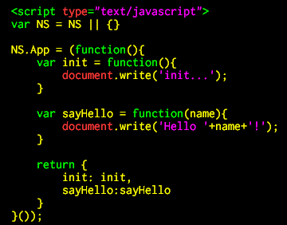
Revealing Module Pattern
Live Demo

Slide 18

The Revealing Prototype Pattern
Reveal the Most Interesting Members through the Object Prototype

Slide 19
Revealing Prototype Pattern: Structure
var Constructor = function () {
// constructor defined here
}
Constructor.prototype = (function() {
var privateFunc = 5; // hidden variables
function privateFunc() { … } // hidden functions
return {
someFunc: pointerToSomeFunc
anotherFunc: pointerToAnotherFunc
};
}());
Create IIFE for the prototype

Slide 20
Revealing Prototype Pattern – Example
var Calculator = function (name) { … };
Calculator.prototype = (function () {
var add, subtract, showResult, formatResult;
add = function (x) { … };
subtract = function (x) { … };
showResult = function () { … };
return {
add: add,
subtract: subtract,
showResult: showResult
};
}());
var calc = new Calculator('First');
We can have hidden data in the prototype
Expose only public methods for the prototype

Slide 21
Revealing Prototype Pattern – Pros and Cons
Pros:
"Modularize" code into re-useable objects
Variables / functions taken out of the global namespace
Expose only public members
Functions are loaded into memory once only
Extensible
Cons:
Using "this" can be tricky
Constructor is separated from the prototype
Can not be used on inheritance

Slide 22
Revealing Prototype Pattern – Summary
Revealing Prototype Pattern provides encapsulation of variables and functions
Provides a way to add visibility
Exposed versus hidden members
Provides extension capabilities

Slide 23

Revealing Prototype Pattern
Live Demo

Slide 24

Singleton Pattern in JS
One Object to Rule Them All!

Slide 25
Singleton Pattern: Structure
var module = (function() {
var SingletonClass, instance;
return {
getInstance: function() {
if (!instance) {
instance = new SingletonClass();
}
return instance;
}
};
}());

Slide 26
Singleton Pattern – Example
var controls = function () {
var Calculator, calculatorInstance;
Calculator = (function () {
function Calculator() { … }
return Calculator;
}());
return {
getCalculator: function () {
if (!calculatorInstance) {
calculatorInstance = new Calculator();
}
return calculatorInstance;
}
};
}();
var calculator = controls.getCalculator();
Create the instance only at first invoke

Slide 27

Singleton Pattern in JS
Live Demo

Slide 28
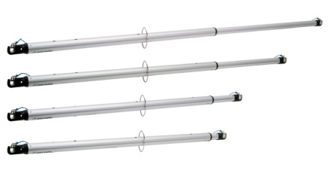
Augmenting Modules
Live Demo

Slide 29
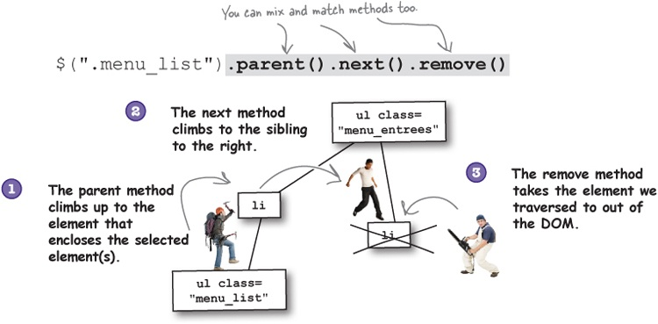
Method Chaining Pattern

Slide 30
JavaScript Method Chaining
Method chaining is a technique (pattern) that involve calling multiple functions on the same object consecutively
Much cleaner code
The code is easier to understand
No need of temporary variables to save each step of the process
var doggy = new Dog();
doggy.setName("Fluffy");
doggy.setColor("purple");
doggy.setGender("male");
var doggy = new Dog()
.setName("Fluffy")
.setColor("purple")
.setGender("male");

Slide 31
JavaScript Method Chaining – Example
var Dog = function() {
this._name = 'Fluffy';
this._color = 'purple';
}
Dog.prototype.setName = function(name) {
this._name = name;
return this;
}
Dog.prototype.setColor = function(color) {
this._color = color;
return this;
}
var doggy = new Dog().setName('Fluffy').setColor('purple');
console.log(doggy); // { _name: 'Fluffy', _color: 'purple' }

Slide 32
Method Chaining
Live Demo

Slide 33







JavaScript Modules and Patterns
https://softuni.bg/courses/javascript-oop/

Slide 34
License
This course (slides, examples, demos, videos, homework, etc.) is licensed under the "Creative Commons Attribution-NonCommercial-ShareAlike 4.0 International" license
Attribution: this work may contain portions from
“JavaScript Basics" course by Telerik Academy under CC-BY-NC-SA license

Slide 35





Free Trainings @ Software University
Software University Foundation – softuni.org
Software University – High-Quality Education, Profession and Job for Software Developers
softuni.bg
Software University @ Facebook
facebook.com/SoftwareUniversity
Software University @ YouTube
youtube.com/SoftwareUniversity
Software University Forums – forum.softuni.bg

